Slide 1
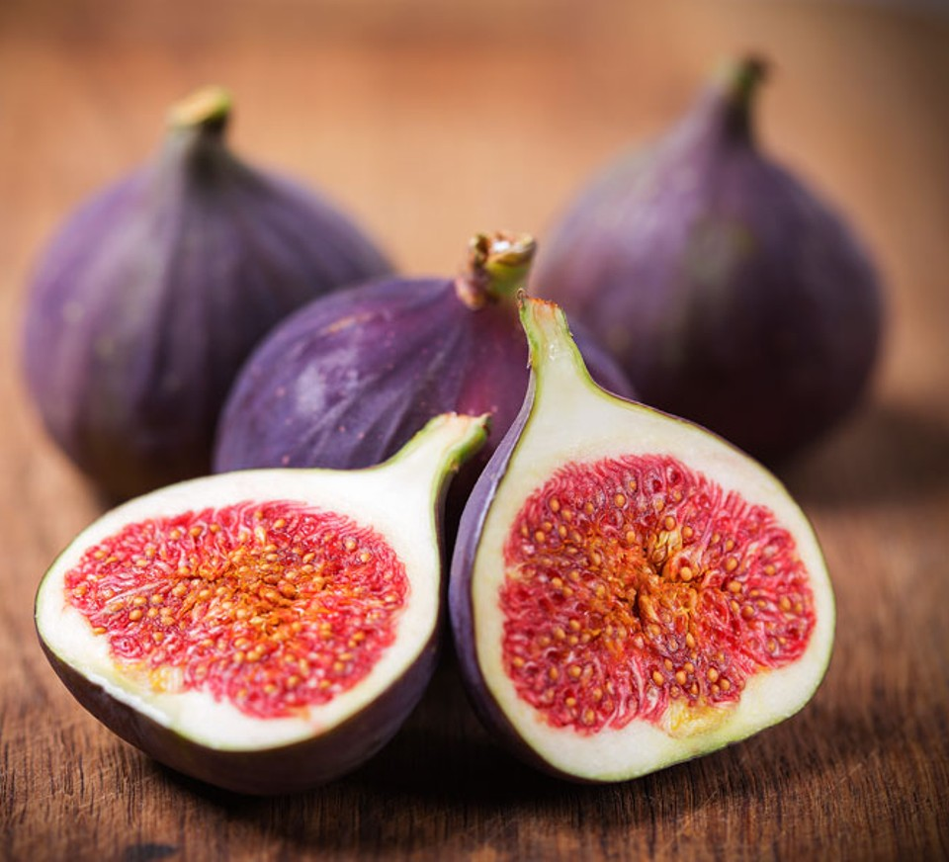
3D-SearchE: Leveraging gene expression and chromatin architecture to identify intergenic enhancers
Paper figs

Slide 2
A)
i) Chromatin interaction dynamics
ii) 3C mapping of interacting fragments
iii) Chromatin Interaction Network
RNA Pol II
P300
Transient
Activation
Enhancer
Enhancer
RNA
Interacting Pair 1
Gene
Interacting Pair 2
Gene Fragment
1° Intergenic
Interacting Pair 3
2° Intergenic
3° Intergenic
Figure 1. Schematic of converting chromatin dynamics into networks. A) i) Enhancers are localised and can influence the regulation of promoters directly and indirectly. ii) 3C can capture chromatin interactions but only in a pairwise manner. iii) Representation of chromatin fragments as nodes in a network and their interactions as edges preserves indirect associations between interacting chromatin.

Slide 3
A
Chromatin Interaction Network
Gene Expression Profile
Gene
node (g)
Gene | Activity
g1
g2
g3
...
High
Promoter
node (p)
Intergenic
node (I)
Low
B
Propagation Step One
Propagation Step Two
C
Ranking of Intergenic Nodes to Predict Enhancers
Intergenic node | Imputed Activity
I1
I8
I6
...
High
I1
I8
I6
Low
Figure 2. Schematic diagram of the network propagation used to impute activity values at intergenic nodes. A) Genes are mapped to nodes representing genic chromatin fragments. Each gene has an associated gene activity value determined by RNA-seq data. B) Gene activity is propagated from gene nodes to genic chromatin nodes in propagation step one. Activity scores are then imputed in intergenic chromatin nodes by propagating the scores from genic chromatin nodes. C) Ranking of non-genic nodes by the imputed activity score to identify high confidence enhancer nodes.

Slide 4
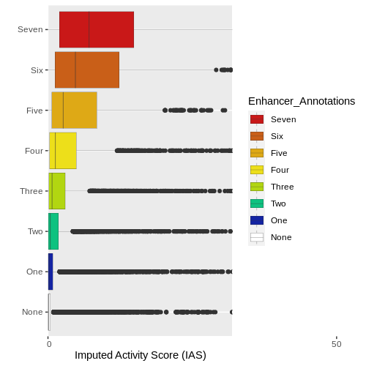
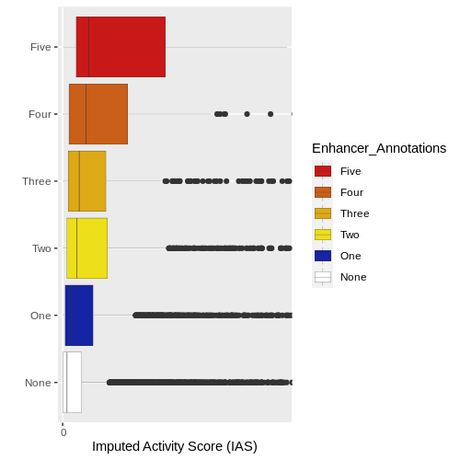
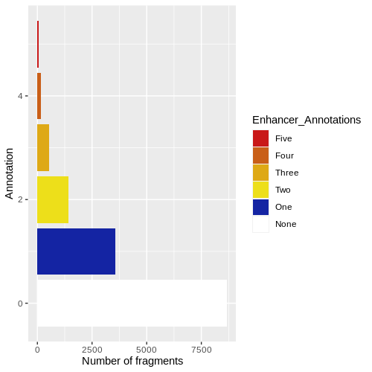
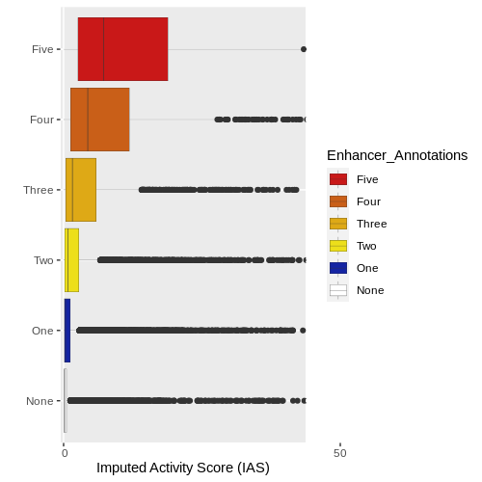
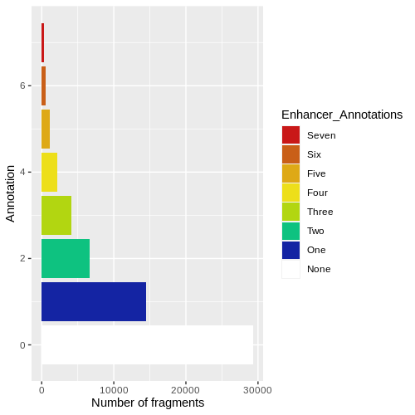
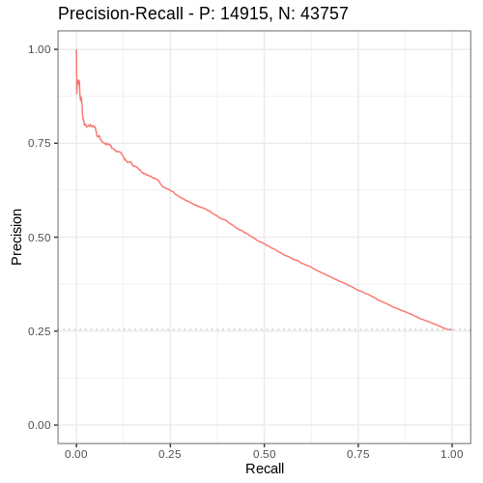
Publically available Sequencing Data
Annotation of the Nodes
ii)
iii)
iv)
i)
TFs
5’
RNA Pol II
Enhancer
3D-SearchE
Two Enhancer Annotations
B
C

Slide 5
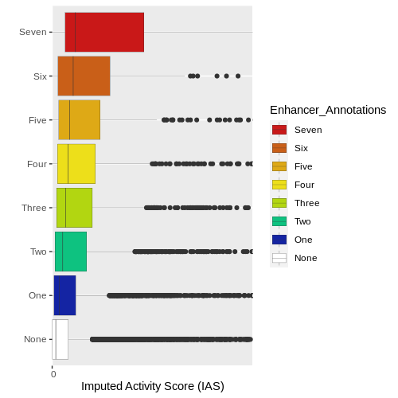
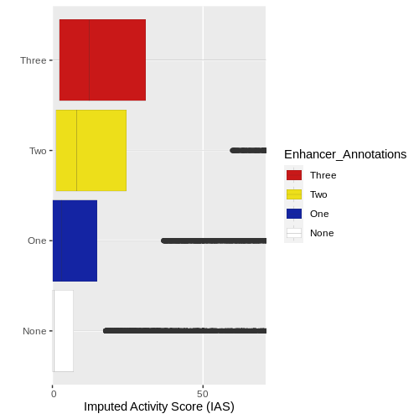
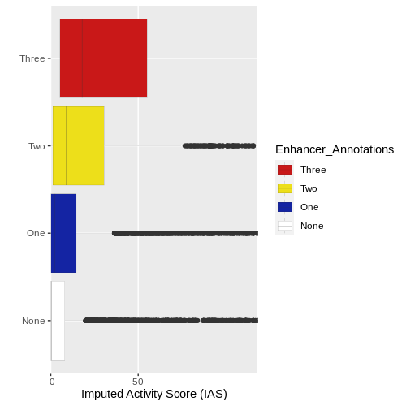
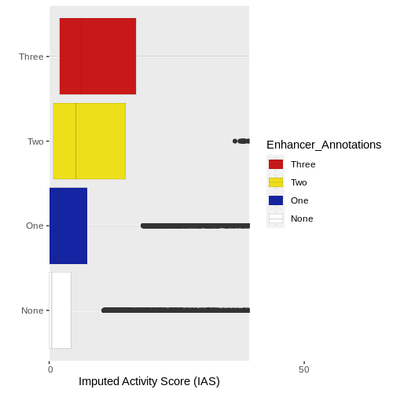
D
E
F
G
Figure 3. A) Example network following the annotation of the nodes using various publicly available data sets. Each node is annotated with 0 to 7 features for the mESCs and 0 to 3 features for the primary immune cells B) Intergenic nodes are stratified into enhancer and non-enhancer groups based on the number of enhancer associated features that were annotated previously. The imputed activity score is then plotted along the X-axis for each group of nodes. The enhancer group contain a significantly higher average imputed activity score compared to the non-enhancer group (Wilcoxon rank sum test p.value = <2.2e-16). C) The number of intergenic nodes that contain 0 to 7 enhancer annotations. D) IAS enrichment in each set for the mESC PCHI-C derived network. D) IAS enrichment in each set for the monocyte PCHI-C derived network. D) IAS enrichment in each set for the neutrophil PCHI-C derived network. D) IAS enrichment in each set for the CD4+ T-Cell PCHI-C derived network.

Slide 6
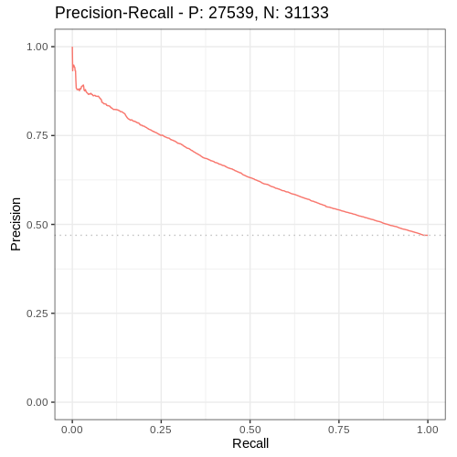
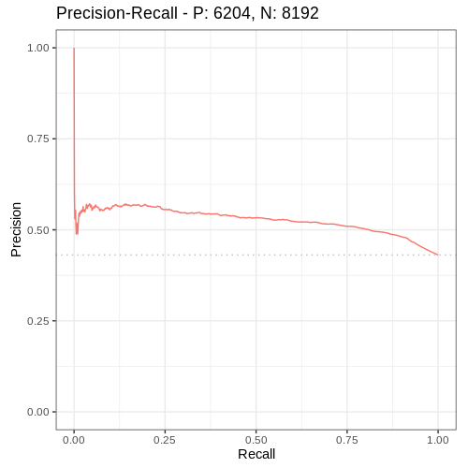
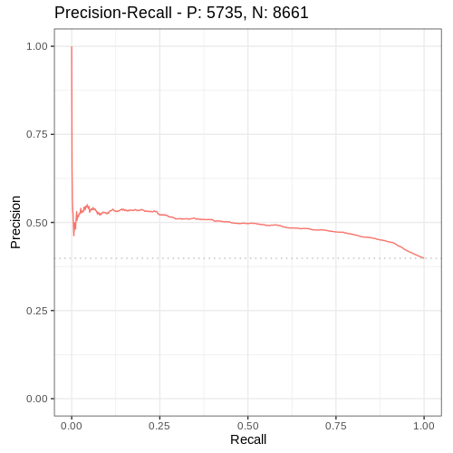
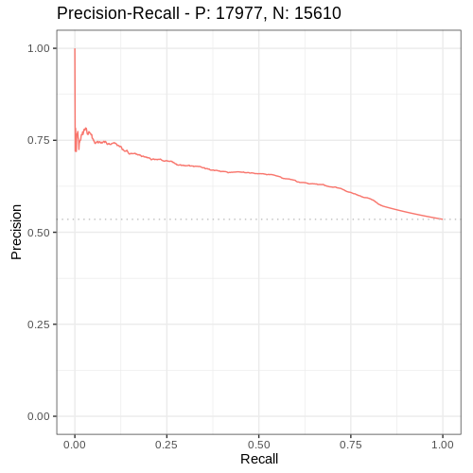
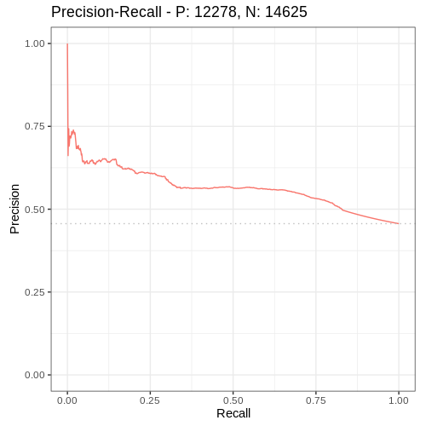
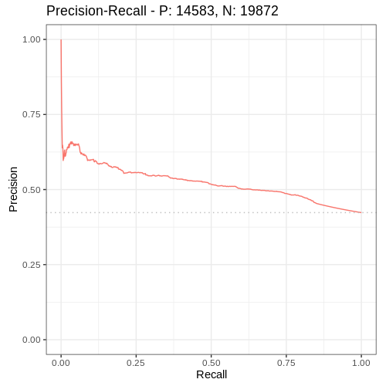
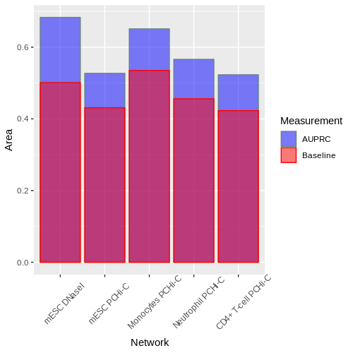
A
B
C
D
E
F
Figure 4. A precision recall curve measuring the overall performance of IAS in the prediction of enhancer nodes containing a minimum of 1 enhancer feature. A) mESC DNaseI derived network AUPRC = 0.683 over a baseline of 0.501. B) mESC PCHi-C derived network AUPRC = 0.527 over a baseline of 0.431. C) Monocytesderived network AUPRC = 0.0.651 over a baseline of 0.535., D) Neutrophil derived network AUPRC = 0.566 over a baseline of 0.456. E) CD4+ T-Cell derived network AUPRC = 0.0.523 over a baseline of 0.423. F) An overlay barchart showing the AUPRC (blue) relative to the baseline score (red) for each of the the precision recall curves with a difference of
Notes:
DNase 0.683/0.501
PCHIC 0.527/0.431
Mono 0.651/0.535
Neut 0.566/0.456
T-Cell 0.523/0.423

Slide 7
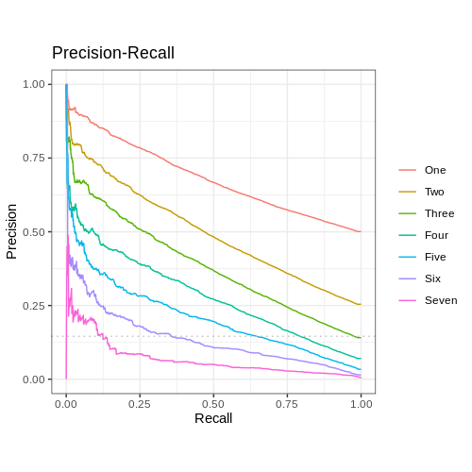
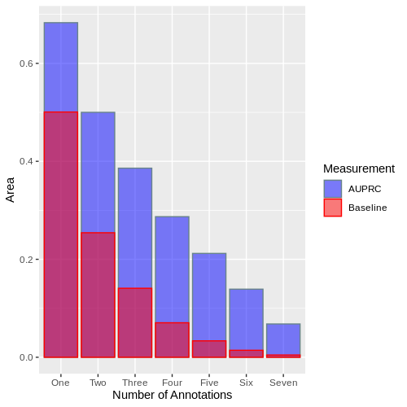
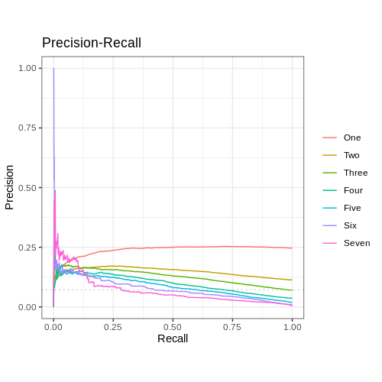
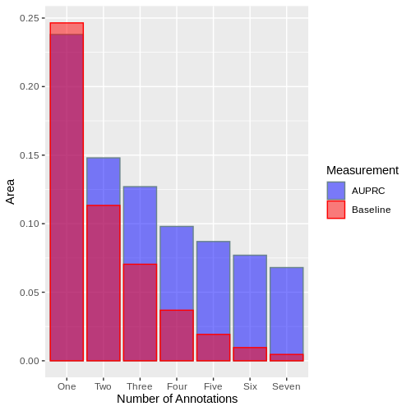
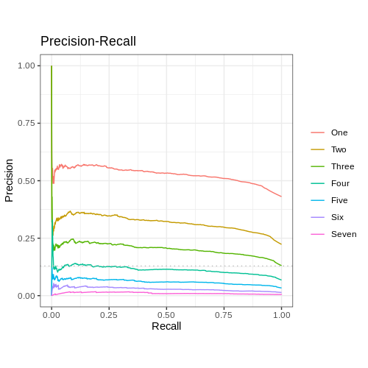
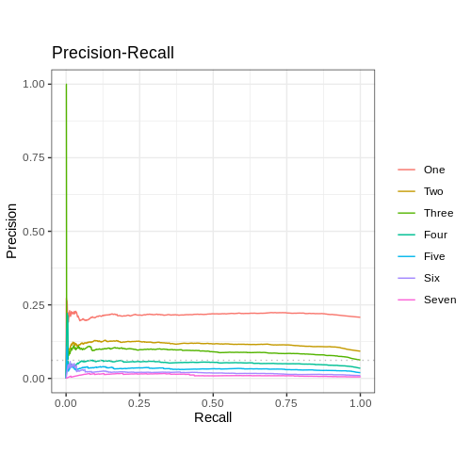
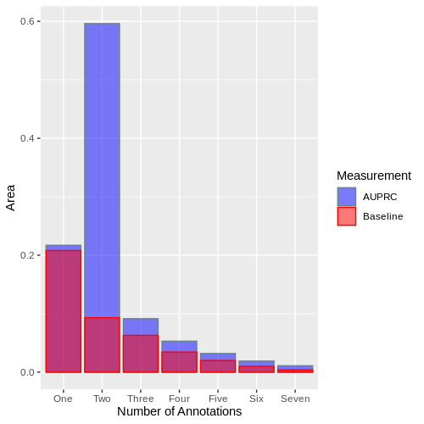
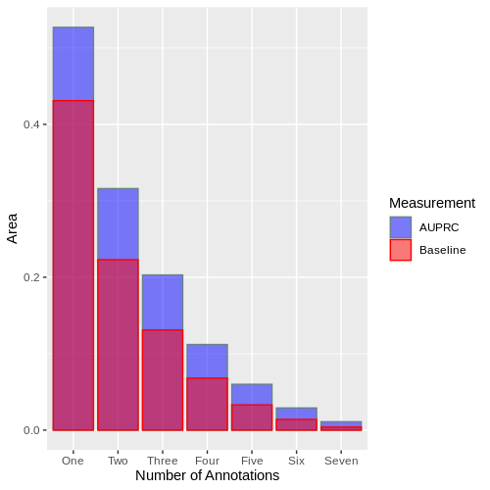
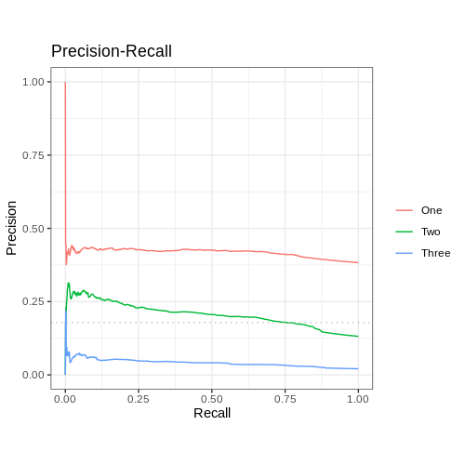
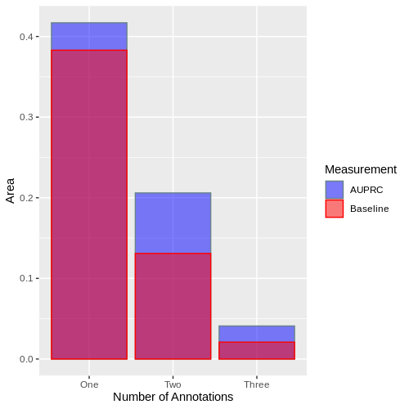

Slide 8

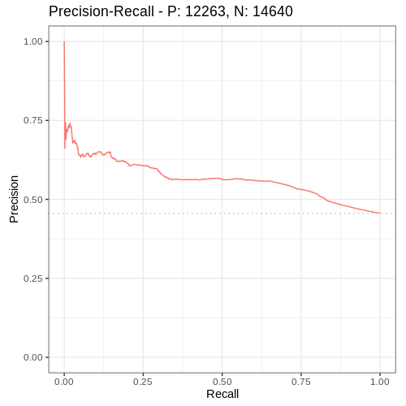
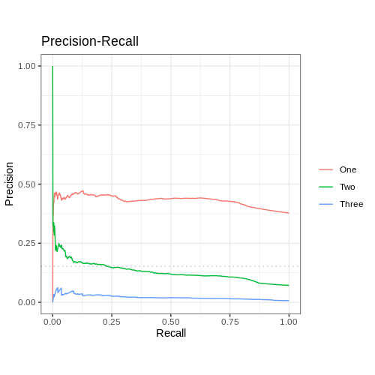
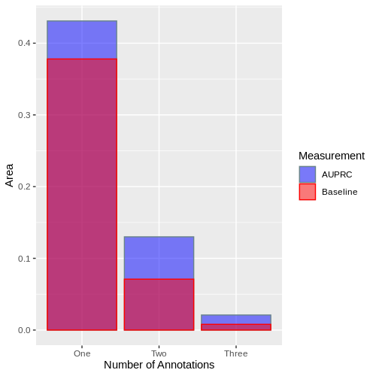
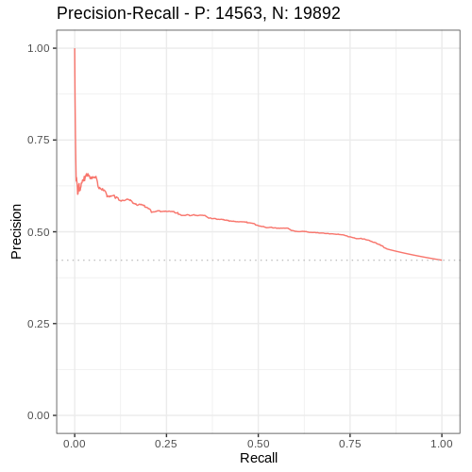
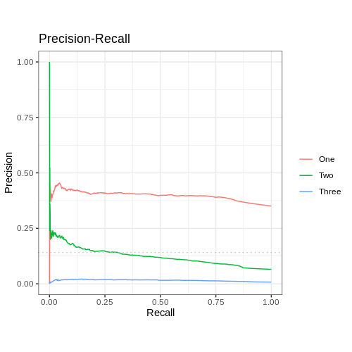

Figure 4. A) A precision recall curve measuring the overall performance of IAS in the prediction of enhancer nodes containing at minimum 1 to 7 enhancer annotation (AUPRC = 0.68, Baseline = 0.5). B) An overlay barchart showing the AUPRC (blue) relative to the baseline score (red) for the precision recall curve in part A. C) A precision recall curve for groups of nodes containing exactly 1 to 7 enhancer annotations. D) An overlay barchart showing the AUPRC (blue) relative to the baseline score (red) for the precision recall curve in part B.
Notes:
Mono 0.650 over 0.534
Neut 0.565 over 0.456
Tcell 0.522 over 0.423

Slide 9
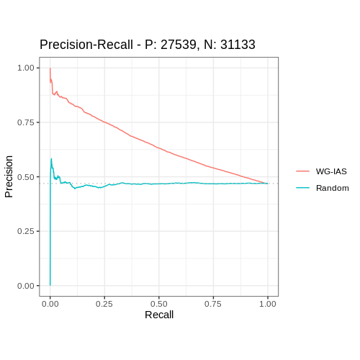
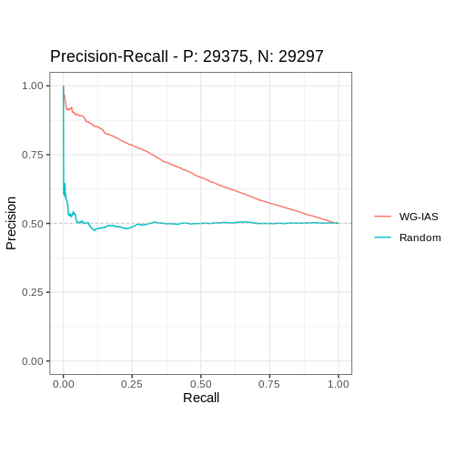
A
Real Network
Degree Preserved Randomised Network
B
Figure 5. WG IAS vs a randomised model A) A schematic of how the degree preserving randomisation rewires the network while preserving the degree of each node. Precision-recall curve for the randomised ChIN vs the non-randomised mESC DNaseI derived ChIN. For the non-randomised network the area under the precision recall curve is 0.65. The randomised ChIN AUPRC is 0.498. The baseline is 0.493.

Slide 10
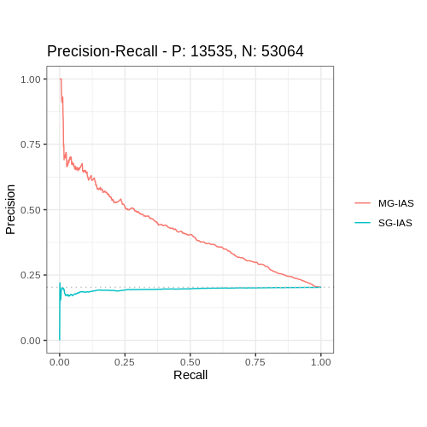
Multi-Gene Propagation
Single-Gene Propagation
I6
I6
Figure 5. A) A schematic of how the degree preserving randomisation rewires the network while preserving the degree of each node. Precision-recall curve for the randomised network vs the non-randomised mESC DNaseI derived network. For the non-randomised network the area under the precision recall curve is 0.68. The randomised network AUPRC is 0.50. The baseline is 0.50. B) A schematic of how multi-gene and single-gene propagation differ in the relative imputed activity scores. Multi-gene propagation highlights I6, an enhancer labelled node, with a higher IAS than single-gene propagation. Precision recall curves for the multi-gene propagation vs the single gene propagation. The mult-gene propagation performs with an AUPRC of X while the single gene propagation AUPRC is X over X.

Slide 11
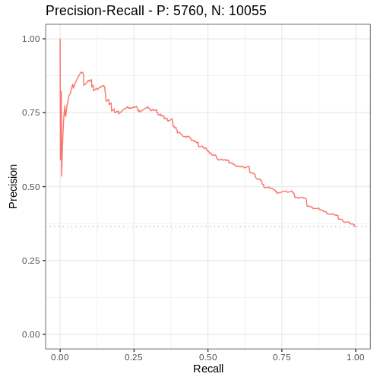
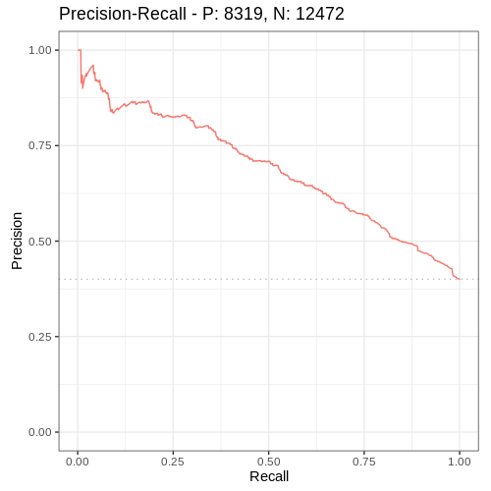
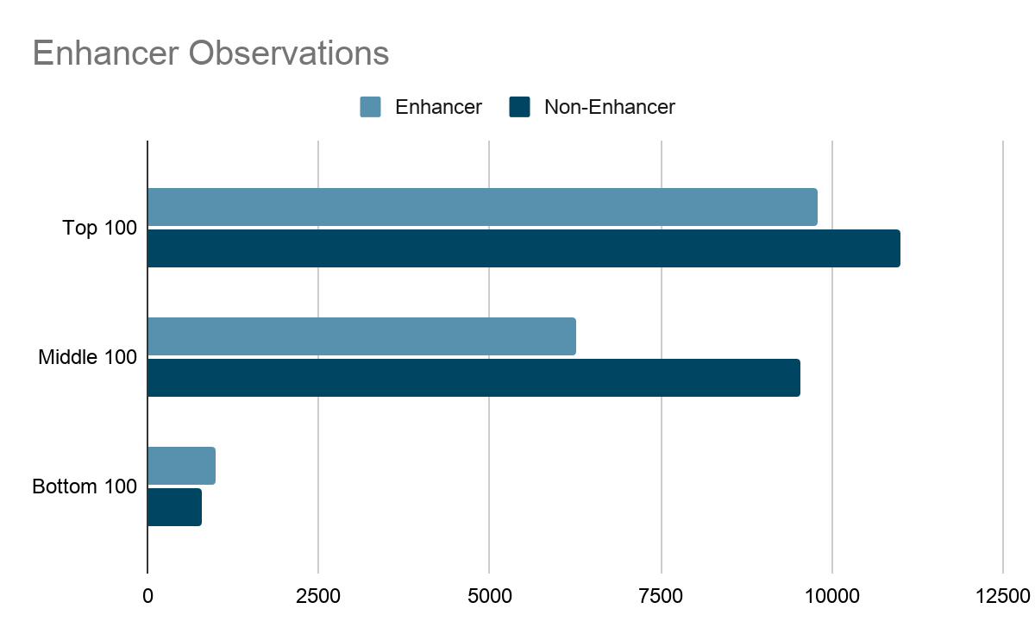
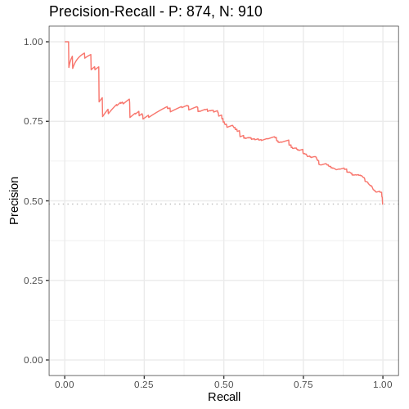
A
Gene Expression Profile
B
Distance Based Intergenic Node Selection
Genes | Activity
Top 100
Middle100
Bottom 100
...
High
d=3
d=2
Low
d=3
d=1
C
Gene Neighbourhood
Aggregate Gene Neighbourhoods By Expression Set
d=3
d=2
d=1
GENE
Top 100 Gene neighbourhoods by Expression
GENE
GENE
GENE
C
D
E
AUPRC
MG-IAS - 0.62
AUPRC
MG-IAS - 0.69
D
Figure 8. A) i) Genes were grouped into expression sets based on relative expression levels and the top, middle and bottom 100 genes were selected. B) For each gene in each expression set, a group of intergenic nodes were selected based on a distance of 3 from the gene node. C) Each gene has a defined neighbourhood consisting of all intergenic nodes within a distance of three. Each neighbourhood is then aggregated into three groups defined by the expression sets. D) The AUPRC was then calculated for each of the three expression sets to identify if the predictive performance is consistent across high, medium and low expressed regions of the network.Top 100 AUPRC = 0.69, middle 100 AUPRC = 0.62, bottom AUPRC = 0.73. E) The total number of nodes in each expression set and the proportion of enhancer vs non-enhancer nodes in each group
The aggregate performance of the model across all the neighbourhoods in each expression set was then calculated; Top 100 AUPRC = 0.69, middle 100 AUPRC = 0.62, bottom AUPRC = 0.73.
AUPRC
MG-IAS - 0.73

Slide 12
Supplementary material

Slide 13
A
Euchromatin
Heterochromatin
i) Direct recruitment of transcriptional machinery
RNA Pol II
Enhancer
TFs
Cohesin
RNA Pol II
Enhancer
P300
ii) Recruitment of chromatin modifiers
Enhancer
RNA
Enhancer
iii) Production of enhancer RNAs
B
i) Chromatin interaction dynamics
ii) 3C mapping of interacting fragments
iii) Chromatin Interaction Network
RNA Pol II
P300
Transient
Activation
Enhancer
Enhancer
RNA
Interacting Pair 1
Gene
Interacting Pair 2
Gene Fragment
1° Intergenic
Interacting Pair 3
2° Intergenic
3° Intergenic
Figure X. A) Schematic diagram of gene regulation by enhancer elements mediated by chromatin dynamics. i) The recruitment of transcriptional machinery such as RNA polymerase II by enhancers facilitate transcriptional upregulation by direct physical localisation to their target genes. ii) Relaxing chromatin structure by recruitment of P300 which has histone acetyltransferase (HAT) activity. iii) Formation of eRNA by transcription of the enhancer sequence for cis and trans effects on gene regulation. B) Schematic of converting chromatin dynamics into networks. i) Enhancers are localised and can influence the regulation of promoters directly and indirectly. ii) 3C can capture chromatin interactions but only in a pairwise manner. iii) Representation of chromatin fragments as nodes in a network and their interactions as edges preserves indirect associations between interacting chromatin

Slide 14
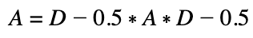
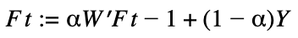
A)
Network Propagation
i)
ii)
iii)
A
A
A
B
C
D
B
C
D
B
C
D
E
F
E
F
E
F
B)
i)
ii)
Adjacency Matrix
Diagonal Matrix
A | B | C | D | E | F
0 | 1 | 1 | 1 | 0 | 0
1 | 0 | 0 | 0 | 1 | 0
1 | 0 | 0 | 0 | 0 | 1
1 | 0 | 0 | 0 | 0 | 0
0 | 1 | 0 | 0 | 0 | 0
0 | 0 | 1 | 0 | 0 | 0
A | B | C | D | E | F
3 | 0 | 0 | 0 | 0 | 0
0 | 2 | 0 | 0 | 0 | 0
0 | 0 | 2 | 0 | 0 | 0
0 | 0 | 0 | 1 | 0 | 0
0 | 0 | 0 | 0 | 1 | 0
0 | 0 | 0 | 0 | 0 | 1
iii)
iv)
Transition Matrix
Expression
A | B | C | D | E | F
0 | 0.3 | 0.3 | 0.3 | 0 | 0
0.5 | 0 | 0 | 0 | 0.5 | 0
0.5 | 0 | 0 | 0 | 0 | 0.5
1 | 0 | 0 | 0 | 0 | 0
0 | 1 | 0 | 0 | 0 | 0
0 | 0 | 1 | 0 | 0 | 0
100 | 0 | 0 | 0 | 0 | 0
I₀
82.21 | 5.59 | 5.59 | 5.48 | 0.56 | 0.56
I₁
69.45 | 9.38 | 9.38 | 9.01 | 1.39 | 1.39
I₂
1)
Equations
2)
Figure 1. A) i) A toy model of network propagation run with two iterations with an insulating score of 0.2. A single gene node A contains an a priori expression value. aii) In the first iteration, the value from A is smoothed to its. aiii) In the second iteration the values are further smoothed and important nodes such as B and C are ranked higher. B) i)This process is achieved by representing the interactions between nodes of the network in an adjacency matrix. ii) The degree of each node is represented in the diagonal matrix. iii) The probabilities of transitioning from one node to another is calculated from the diagonal matrix and the adjacency matrix using equation 1. These results are then represented in the degree-normalised transition matrix. iv) The expression value for each node at the start and after each of the two iteration values after propagation using equation 2.
Notes:
N2a2 propagation

Slide 15
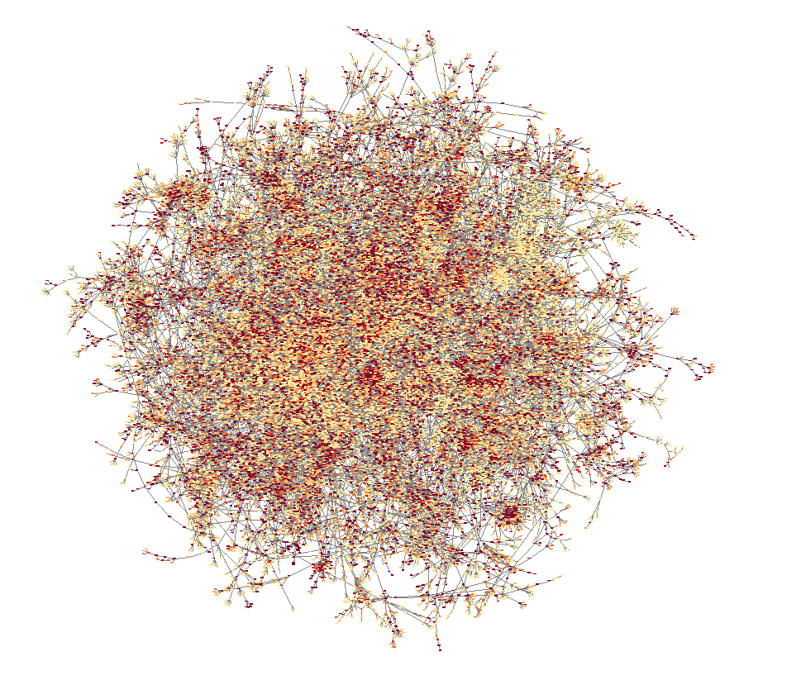
A
B
C
D
Figure X. A) Example network following the propagation of gene expression profiles. Nodes are organised based on an Edge-weighted Spring-Embedded Layout where the frequency of interaction denotes the edge weight. Nodes are then coloured from yellow to red based on the imputed activity score calculated by 3D-SearchE. B) Intergenic nodes are stratified into enhancer and non-enhancer groups based on enhancer chromatin states, P300, starr-seq and FANTOM enhancer annotations and three variants of RNA polymerase II. The imputed activity score is plotted for each group of nodes. The enhancer group contain a significantly higher average imputed activity score compared to the non-enhancer group (Wilcoxon rank sum test p.value = <2.2e-16, W = 573351505). C) The number of intergenic nodes that contain 0 to 7 enhancer annotations. D) The precision-recall curve of IAS when predicting nodes that contain at least two enhancer annotations AUPRC = 0.49 over a baseline of 0.25.

Slide 16
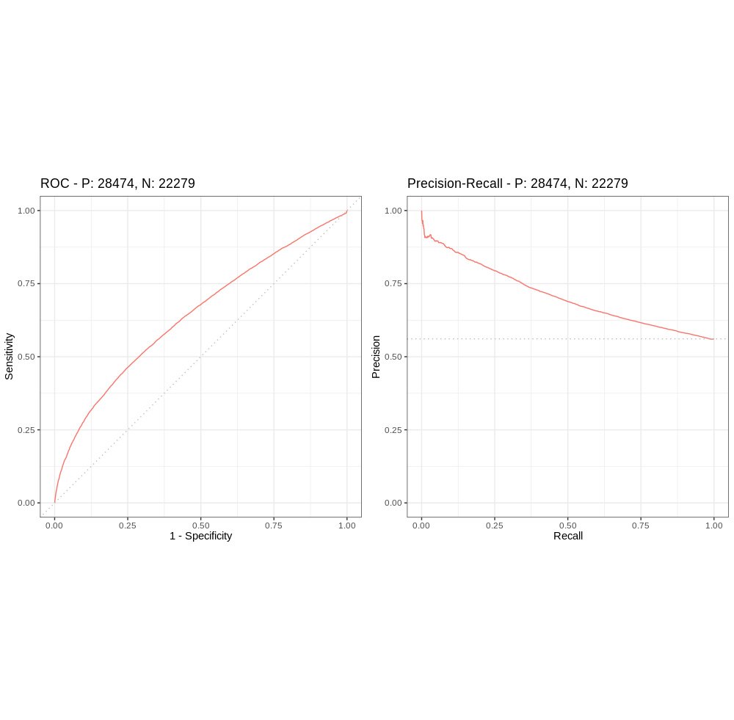
Add Randomisations
Discuss enhancer label threshold
A
Real Network
Degree Preserved Randomised Network
B
Multi-Gene Propagation
Single-Gene Propagation
I6
I6
Add the randomised line in when rocket starts behaving
AUPRC - 0.71
Figure X. A) A schematic of how the degree preserving randomisation rewires the network while preserving the degree of each node. B) A schematic of how multi-gene and single-gene propagation differ in the relative imputed activity scores. Multi-gene propagation highlights I6, an enhancer labelled node, with a higher IAS than single-gene propagation. C) i) Precision-recall curve for the randomised network vs the non-randomised mESC DNaseI derived network. For the non-randomised network the area under the precision recall curve is X over a baseline of X. The randomised network AUPRC is X, over the baseline of X. ii) Precision recall curves for the multi-gene propagation vs the single gene propagation. The mult-gene propagation performs with an AUPRC of X while the single gene propagation AUPRC is X over X.
Notes:
MCC of the model with the randomised propagations shows that the topology is an essential predictor

Slide 17
Vs ChromHmm

Slide 18
A
Publically available Sequencing Data
Annotation of the Nodes
ii)
iii)
iv)
i)
TFs
5’
RNA Pol II
Enhancer
3D-SearchE
B
C
Imagine this but coloured by the features
D
E
Figure X. Annotation and visualisation of nodes in the network. A) Curation of publically available sequencing data to identify enhancers based on i) ChIP-seq of histone marks, ii) ChIP-seq of P300, iii) CAGE-seq, iii) Starr-seq. Nodes are then annotated by overlapping the coordinates of the features and the chromatin fragments represented by each node. B) Visualisation of nodes annotated by enhancer chromatin states. C) Visualisation of nodes annotated by P300. D) Visualisation of nodes annotated by CAGE-seq data. E) Visualisation of nodes annotated by Starr-seq data.

Slide 19
A
Multi-Gene Propagation
Single-Gene Propagation
I6
I6
B
AUPRC
MG-IAS - 0.41
SG-IAS - 0.20
Baseline - 0.20
Figure X.
Notes:
MCC of the model with the randomised propagations shows that the topology is an essential predictor

Slide 20
A
B
C
D
E
PCHi-C
Genic
DNaseI
Non-Genic

Slide 21
Extras

Slide 22
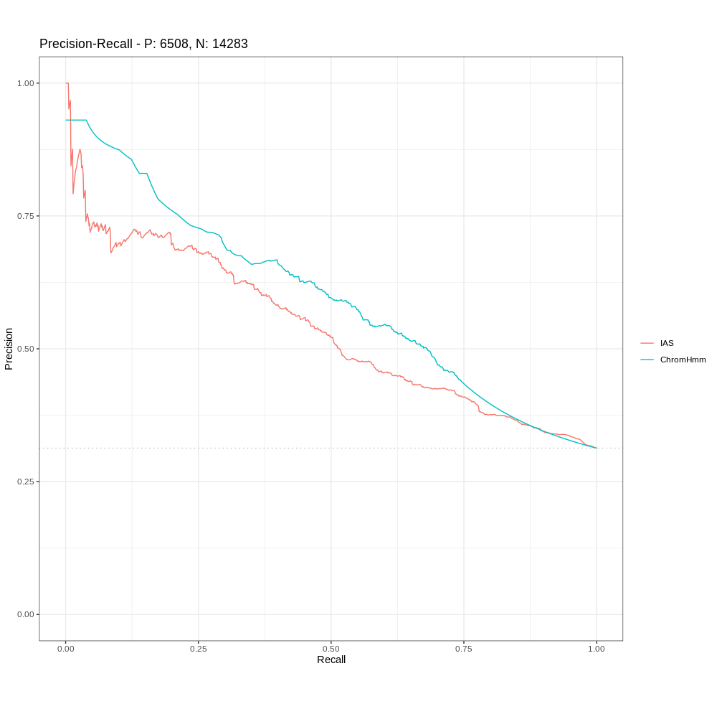
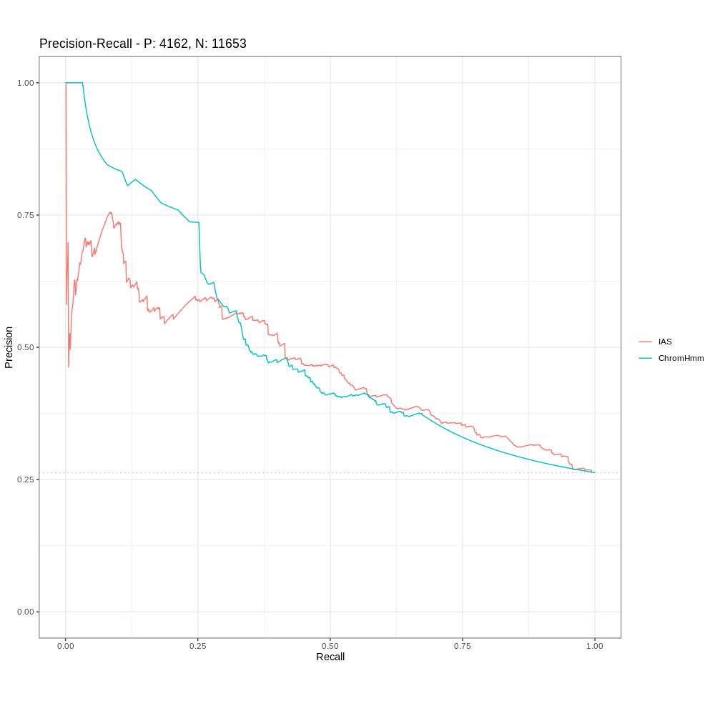
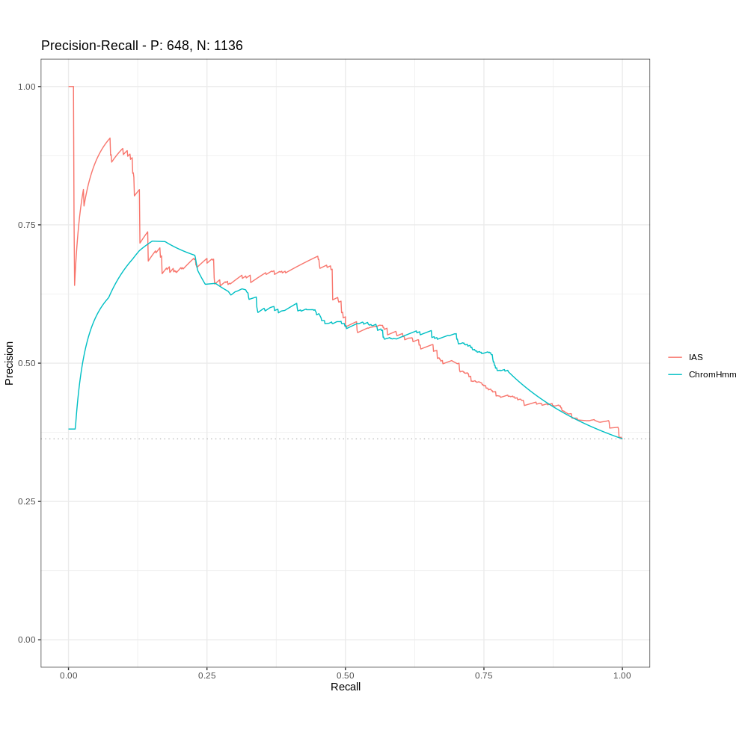
IAS AUPRC = 0.536
CS AUPRC = 0.597
Baseline = 0.31
IAS AUPRC = 0.466
CS AUPRC = 0.503
Baseline = 0.263
IAS AUPRC = 0.595
CS AUPRC = 0.556
Baseline = 0.363
Top, middle and bottom 100 genes by expression distance of 2 degrees

Slide 23
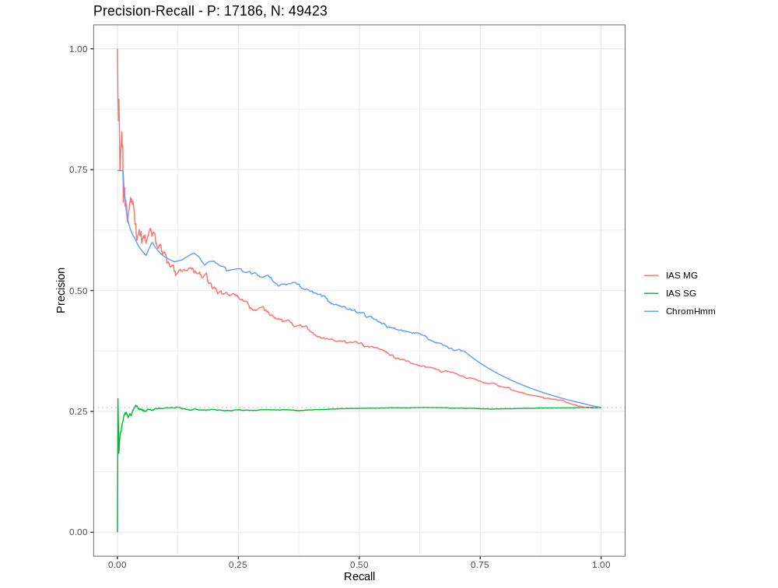

Slide 24
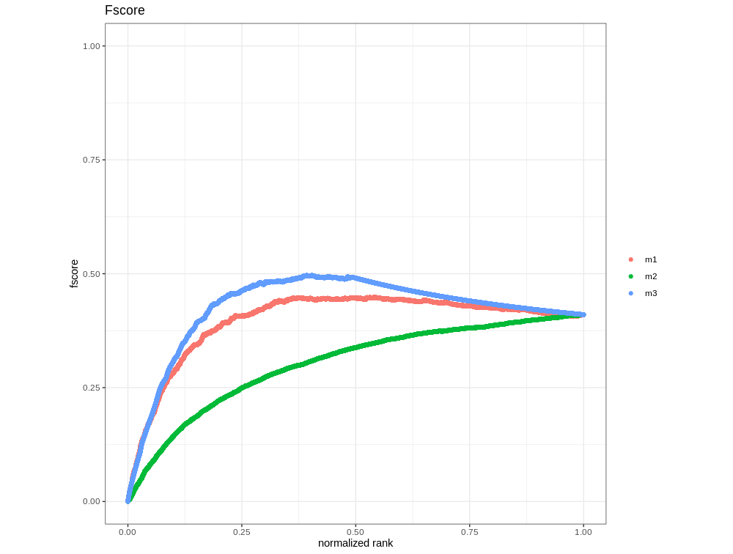

Slide 25
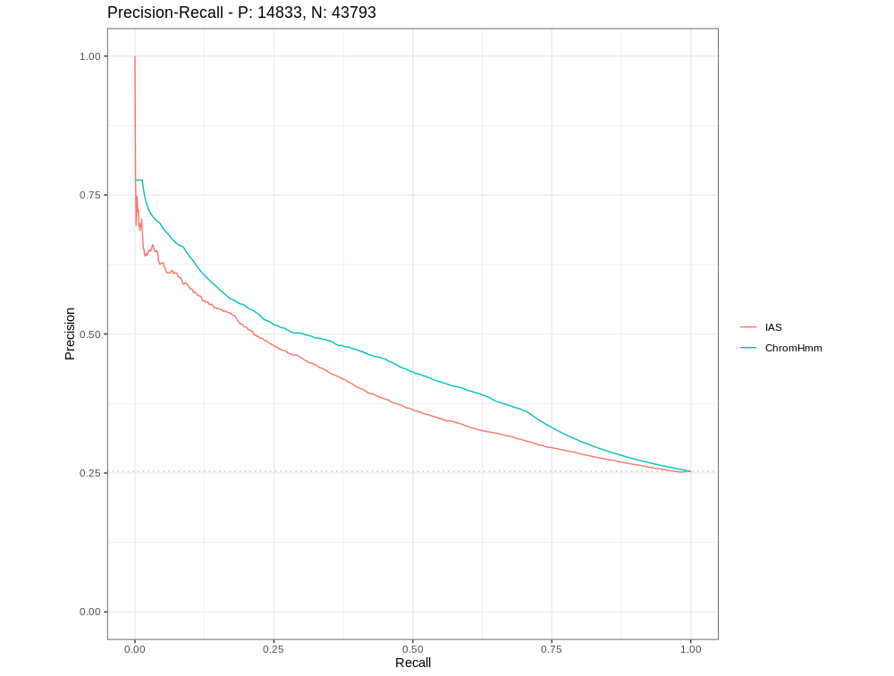


Slide 27


Gene
1°
2°
14,219
PRC 0.7421879 (baseline=0.48)
ROC 0.7533950
Notes:
PRC on 2nd deg enhancer nodes

Slide 28


Stricter enhancer labs
PRC 0.3558392
Baseline=0.09
ROC 0.8428552

Slide 29


Figure X.

Slide 30



Needs edit to match cols and add RNAP
A
B
C
D
Figure X. A) The largest connected component of the monocyte network following the propagation of all mESC gene expression profiles. Nodes are organised based on an Edge-weighted Spring-Embedded Layout where the frequency of interaction denotes the edge weight. Nodes are then coloured from yellow to red based on the imputed activity score calculated by 3D-SearchE. B) Intergenic nodes are stratified into enhancer and non-enhancer groups based on enhancer chromatin states, P300, starr-seq and FANTOM enhancer annotations. The imputed activity score is plotted for each group of nodes. The enhancer group contain a significantly higher average imputed activity score compared to the non-enhancer group (Wilcoxon rank sum test p.value = <2.2e-16, W = 540185474). C) Intergenic nodes are further stratified into 16 groups based on enhancer chromatin states, P300, starr-seq and FANTOM enhancer annotations. For each group the imputed activity score is plotted. The imputed activity score is significantly enriched in intergenic nodes with all 4 enhancer annotations over all other groups (Wilcoxon rank sum test p.value <2.2e-16). D) The total number of intergenic nodes in each group defined by enhancer chromatin states, P300, starr-seq and FANTOM enhancer annotations.

Slide 31
Figure 4. A) A precision recall curve measuring the overall performance of IAS in the prediction of enhancer nodes containing at minimum 1 to 7 enhancer annotation (AUPRC = 0.68, Baseline = 0.5). B) An overlay barchart showing the AUPRC (blue) relative to the baseline score (red) for the precision recall curve in part A. C) A precision recall curve for groups of nodes containing exactly 1 to 7 enhancer annotations. D) An overlay barchart showing the AUPRC (blue) relative to the baseline score (red) for the precision recall curve in part B.

